Slide 1
HPC Eplus
Overview of Abode Enhancements

Slide 2
Major Changes to EPlus
No more Import/Export of information
The ability to search and approve clients through Utility Search
Document storage in Google Drive, via folder link created in Eplus
Invoicing completed directly in EPlus with HPC managing change orders
The ability to create milestones to track phases of WZ projects

Slide 3
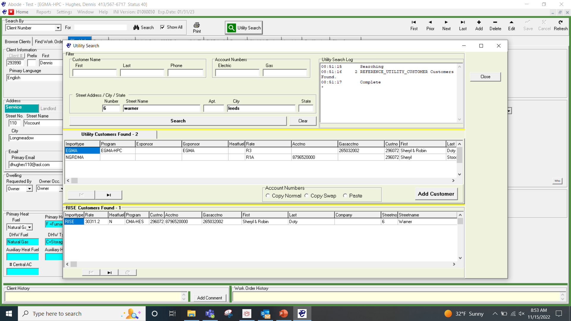
Utility Search
Click utility search
Enter address information and hit search
Pulls up list of accounts for that address
Can also search by client name

Slide 4
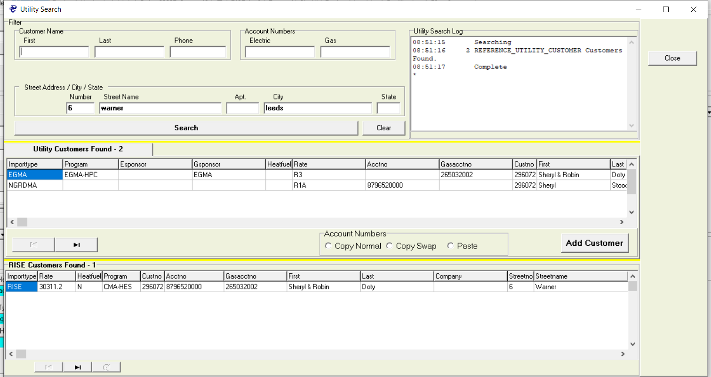
Utility Search cont..
Search will show the rate codes for all accounts. Along with eligibility
If customer is eligible, you can add customer and proceed with assessment
If both gas and electric accounts are present you can select the electric account hit copy normal, then move to gas account and click paste, click add customer and both accounts will be added to the one client number

Slide 5
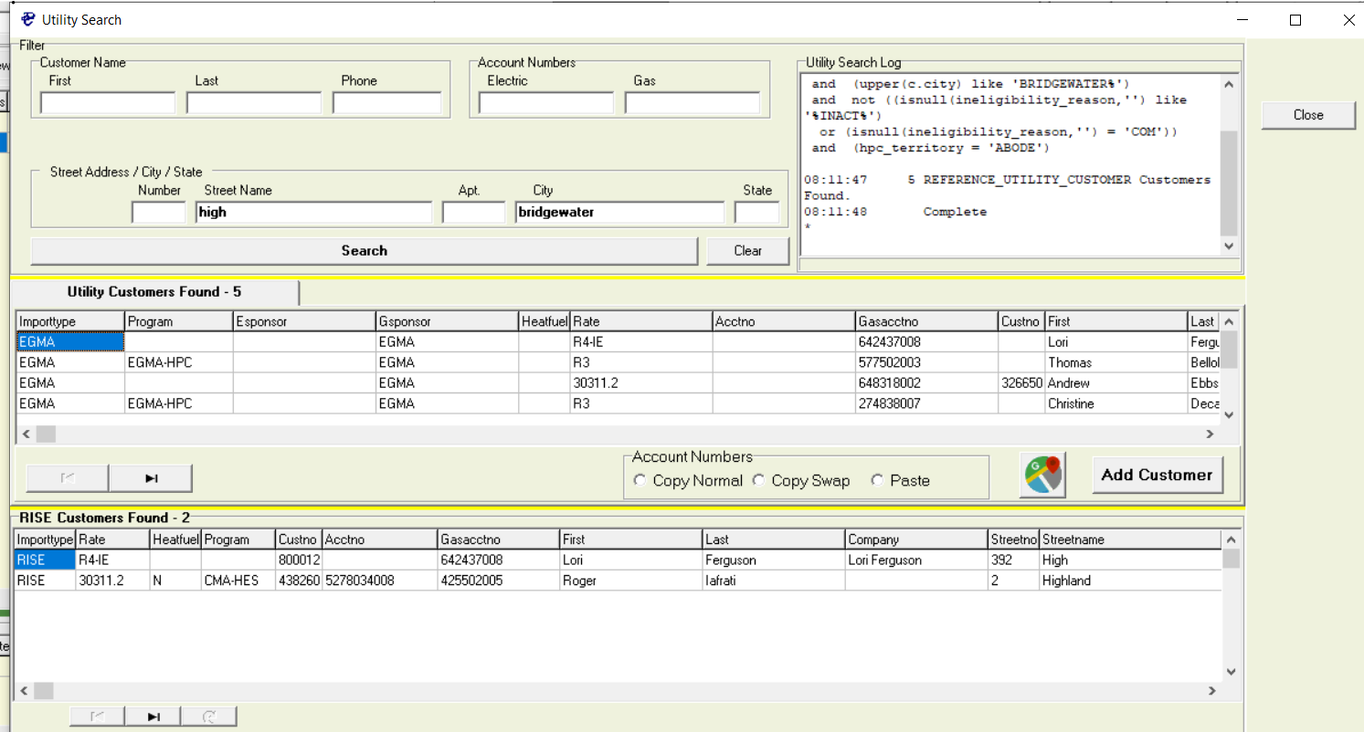
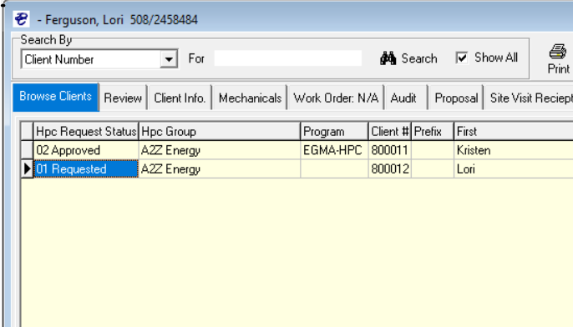
Customer Search Ineligible
If customer is ineligible but you would like Abode to review the reason you can hit add customer
This will put it in your client list as “01 Requested”
Abode will review the client further and make a determination- if approved the customer status will change to an “02 Approved and you can proceed.
If the client is deemed ineligible after review it will be changed to a status “03 Rejected” and you may not proceed.

Slide 6
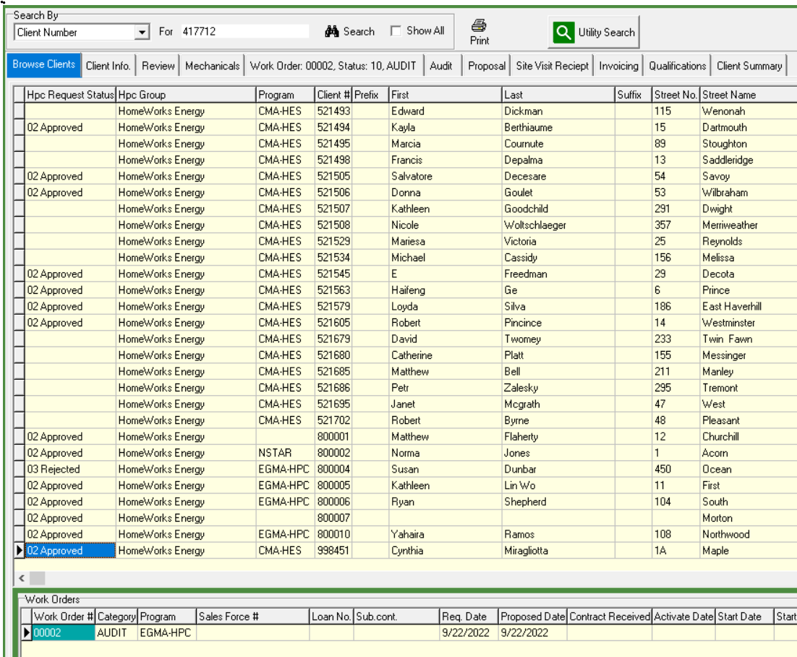
Browse Clients
All clients in Eplus show up here.
When you click on a client number that client is displayed on all other tabs.
You can use search function to search by client number, address, last name etc.

Slide 7
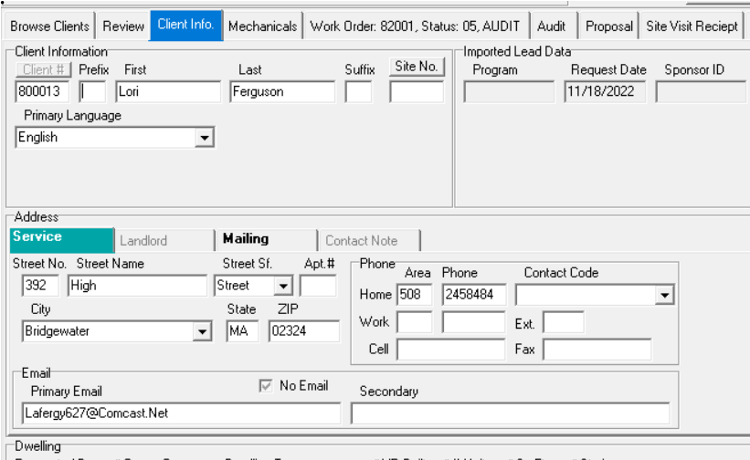
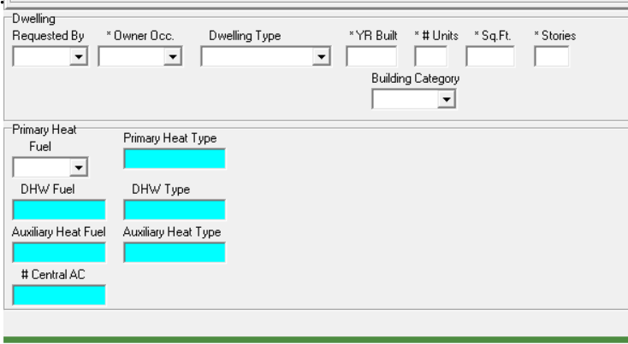
Client Info Left side of Screen
Name, Address, Phone, Email, Primary Language
All Dwelling info must be filled in mandatory fields have an asterisk *.

Slide 8
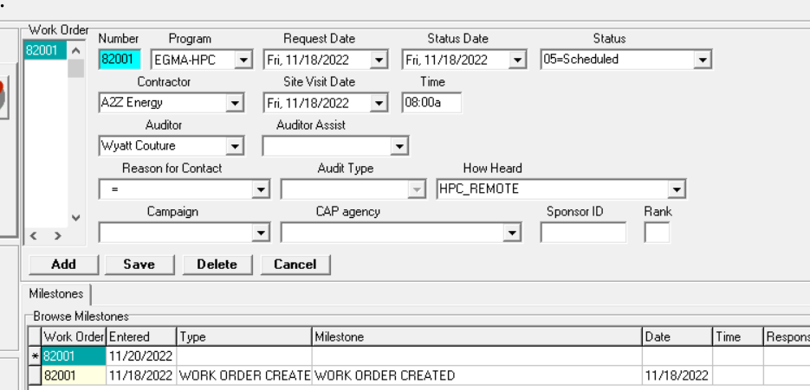
Client Info Right side of screen
Select correct program
Schedule Assessment date and time
Assign to Auditor
Change status as needed
List of milestones for client is visible

Slide 9
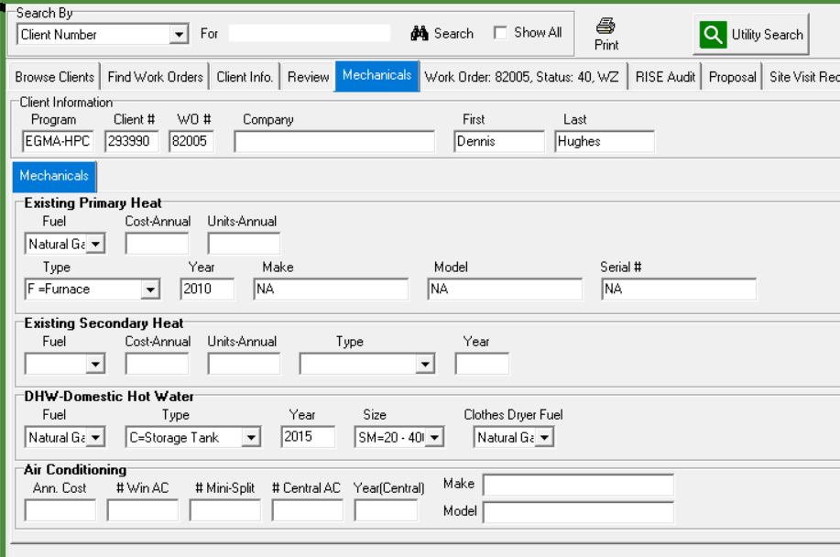
Mechanicals
All Heating and DHW info is entered here
HPC’s should enter this information for all assessments
When creating proposal, the print contract will not function unless all mechanicals are populated for Primary Heat and DHW

Slide 10
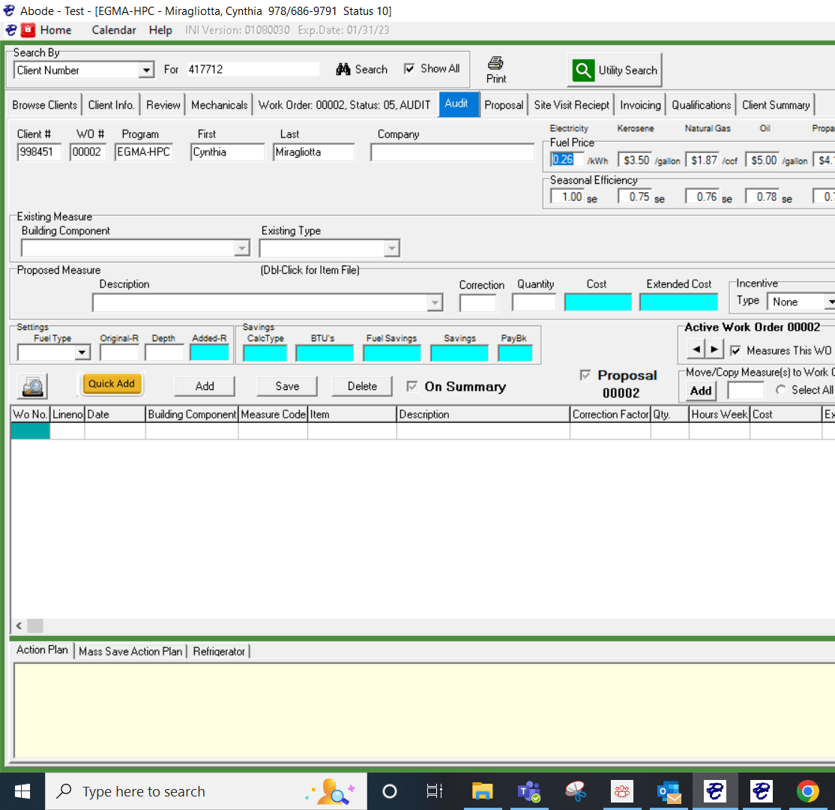
Audit
All assessment measures and recommendations entered
Select measures for Summary and Proposal
All measures selected for proposal automatically get populated in proposal tab for a customer contract

Slide 11
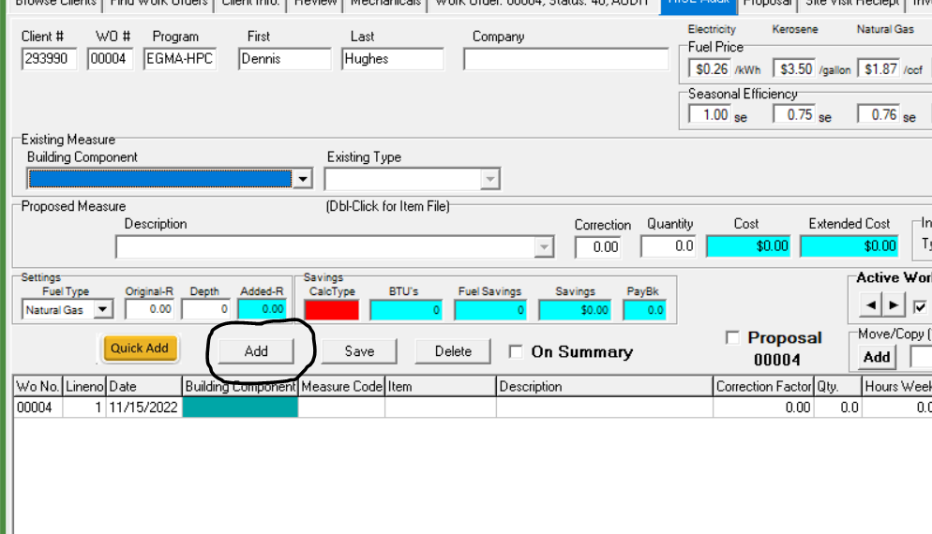
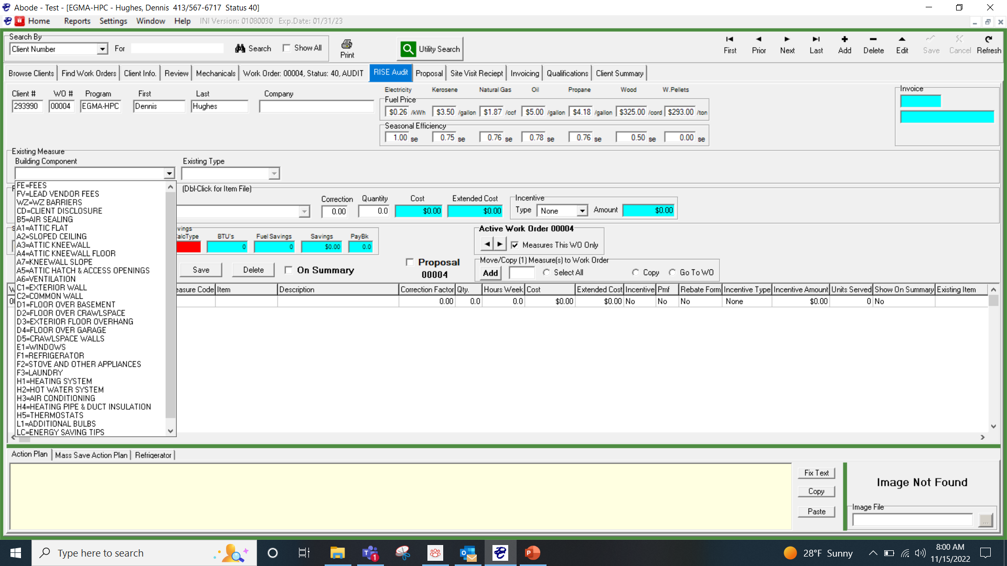
Adding Measures to Audit Tab
Click add button
Select from building component dropdown what area of home you are adding to
Tab over to existing type and select from dropdown
Tab to Description drop down and select measure
Add quantity

Slide 12
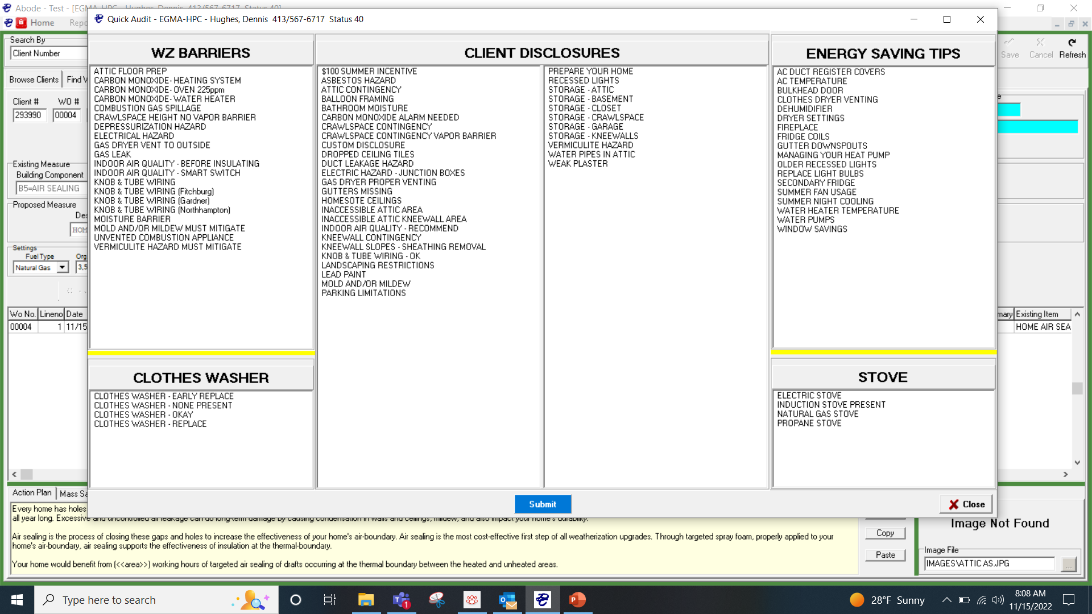
Quick add
The Quick Add button allows you to select several Barriers, Disclosures and energy saving tips at once and add them to the audit tab to be put on the summary for the customer

Slide 13
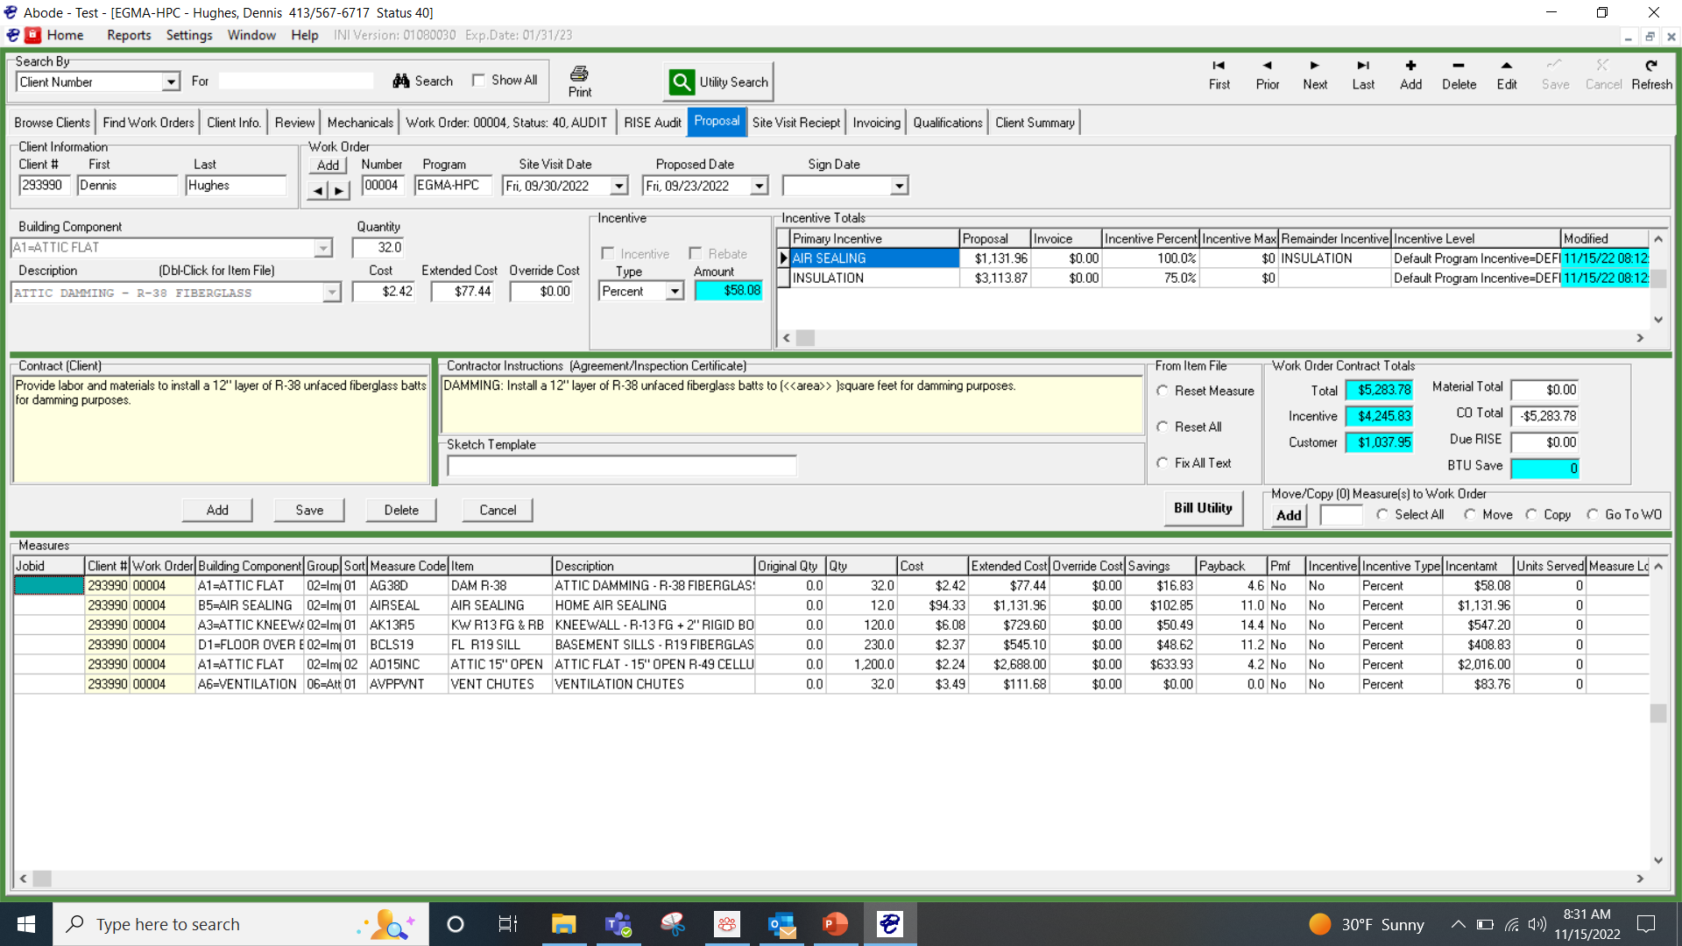
Proposal
All measures that were checked off for proposal on the audit tab populate here
You can print contract from here after making any adjustments needed before sending to the customer
The printed contract will land in the client folder that was created from the audit tab printing- or if you didn’t print from audit tab it will create the folder from here
HPC’s will use this tab to hit Bill Utility for all measures installed. This will populate them on the invoicing tab

Slide 14
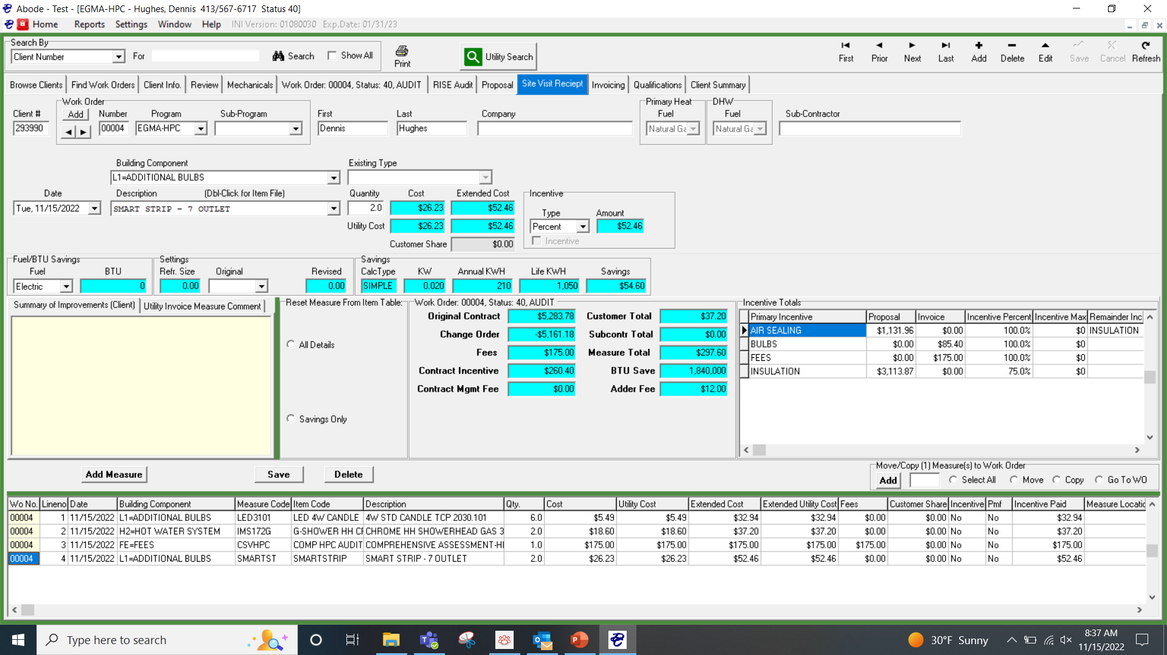
Site Visit Receipt
All ISMS are entered by HPC here
Assessment Fees entered here
When the audit is complete the HPC will upload documents to Google Docs and turn the Audit WO to Audit Complete on the Client Tab

Slide 15
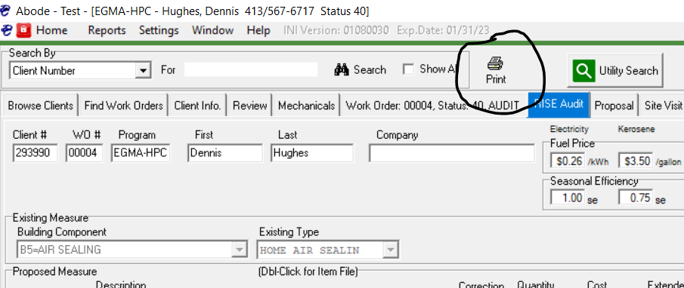
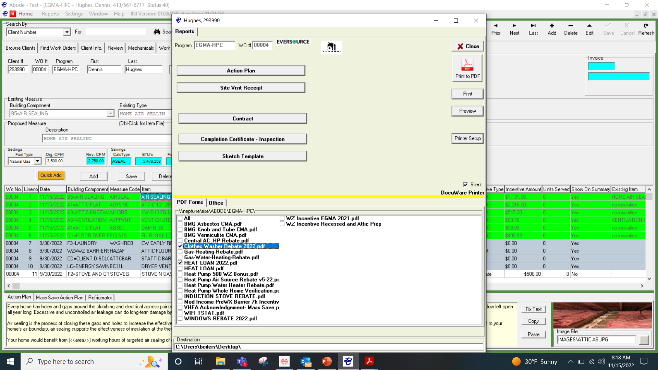
Audit Print
Once the audit is complete you can click the print button from any tab
You can select any rebates or HL forms here and click action Plan then preview and it will queue up all forms pre-filled for the customer
A folder for that customer will appear on desktop with all forms inside

Slide 16
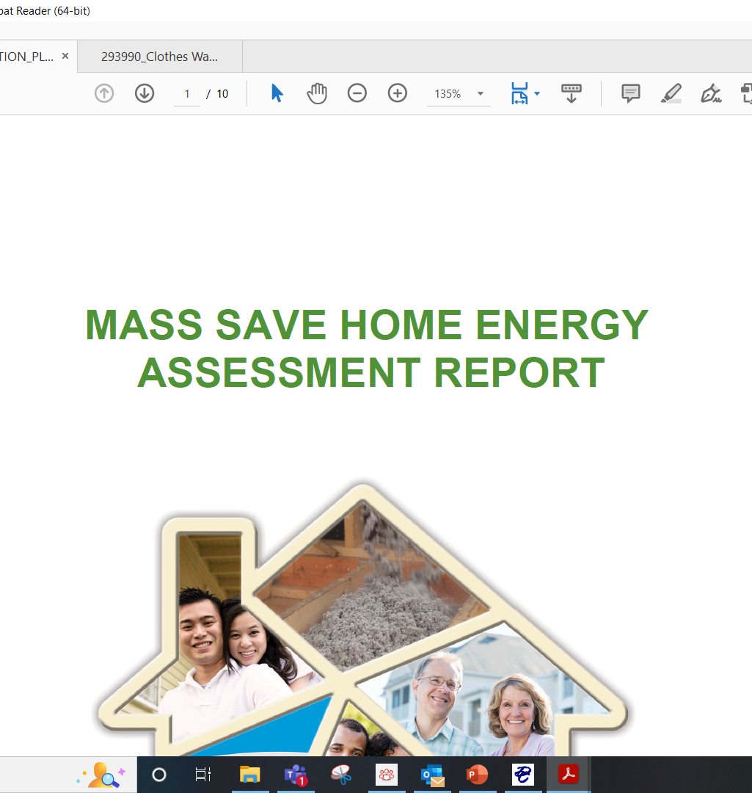
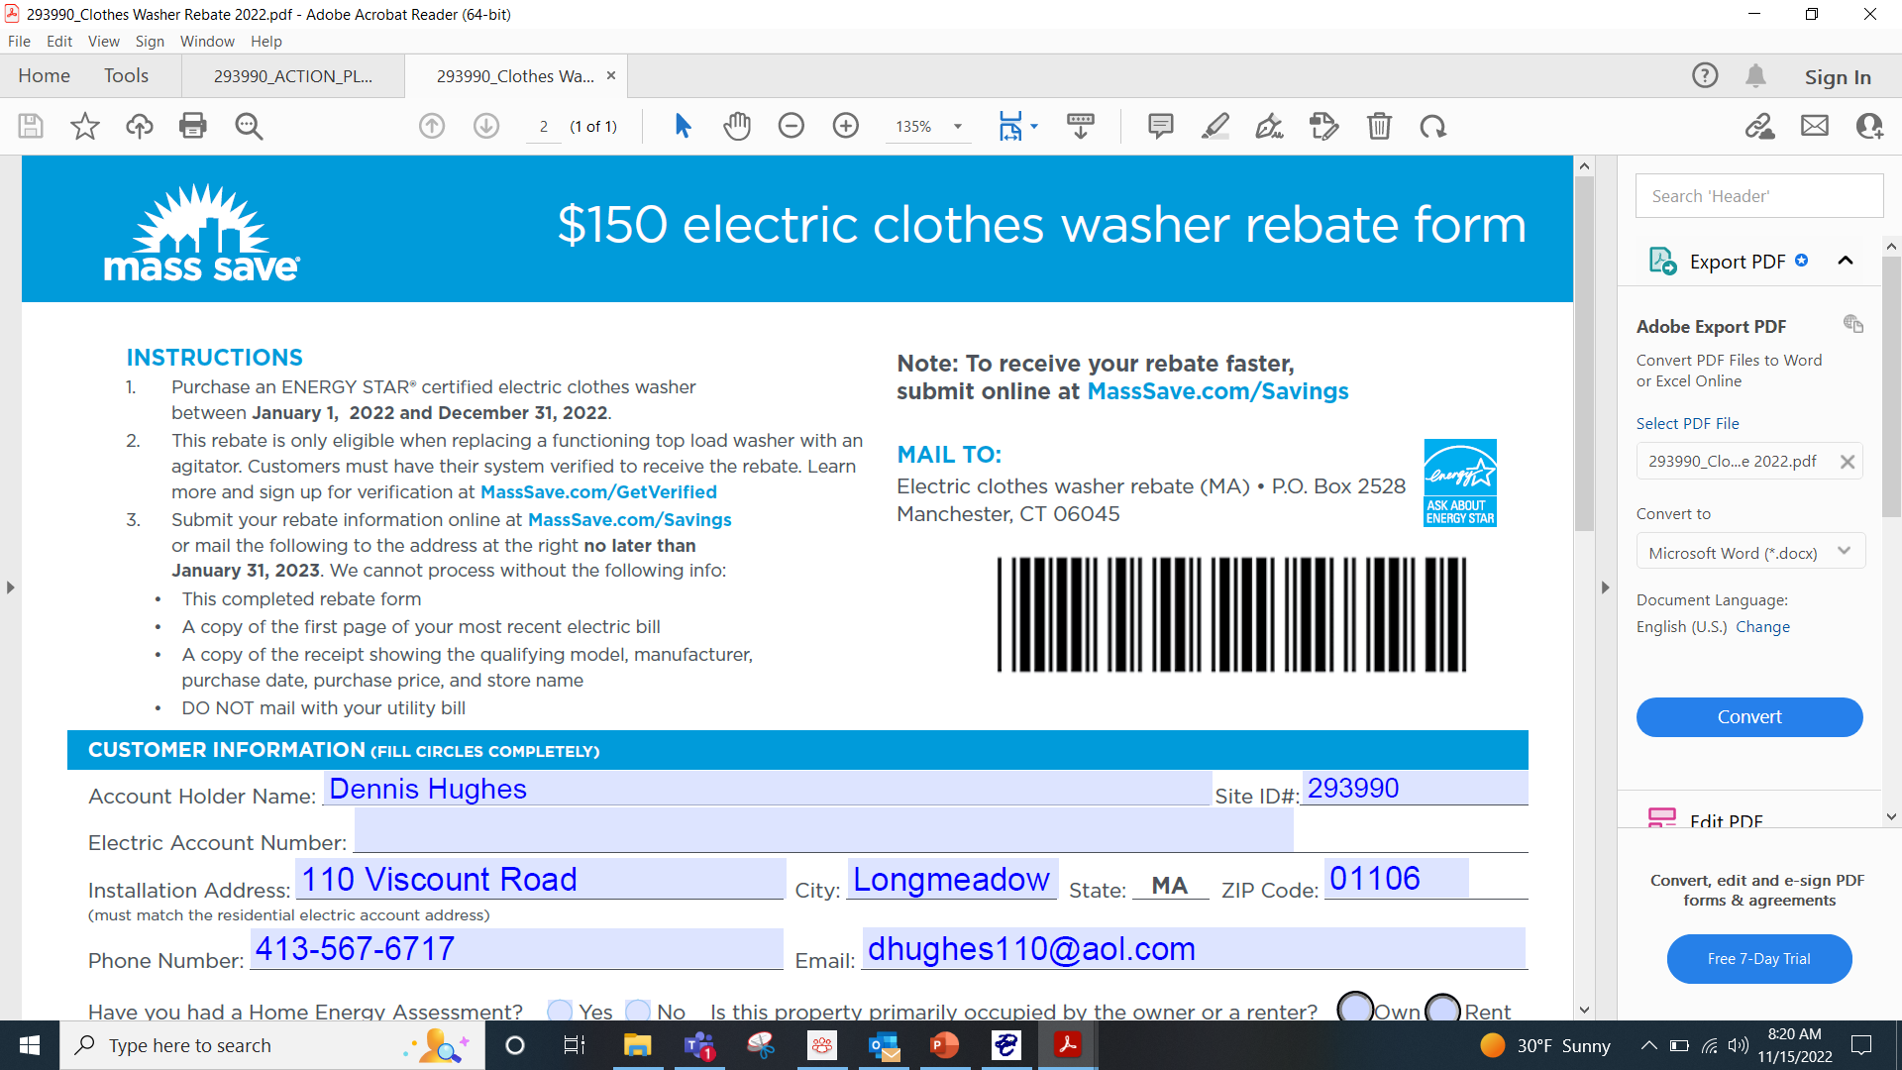

Slide 17
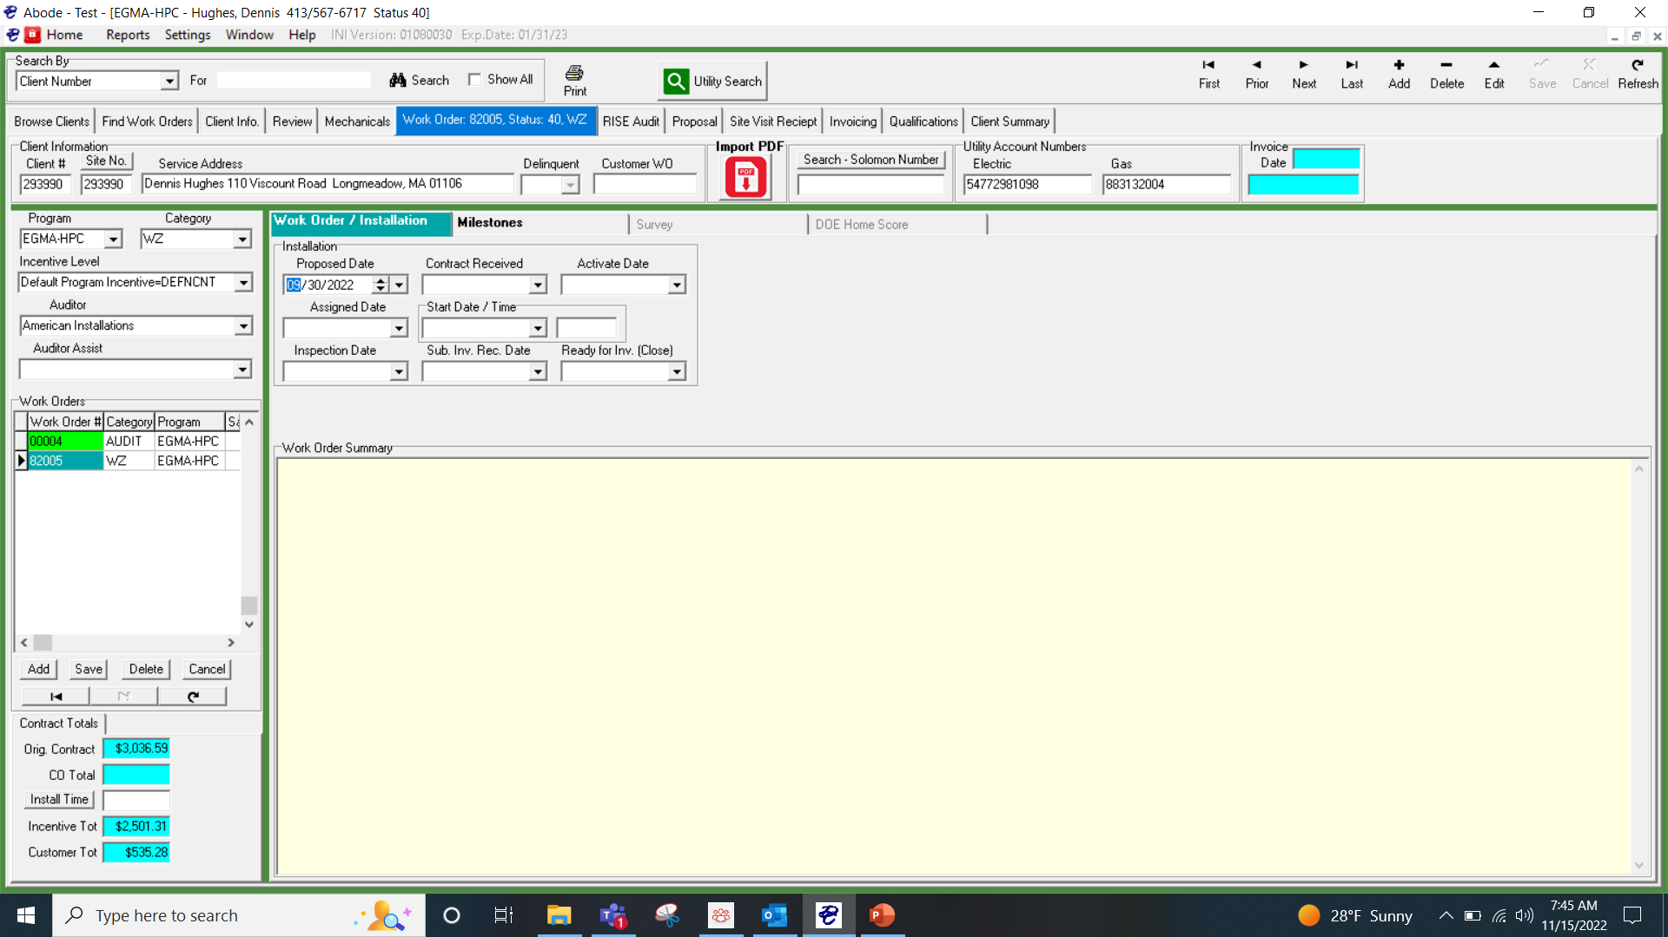
Work Order
A work order is generated when a button is clicked on the proposal tab
Typically you won’t create a work order until you have a signed contract
The work order primary function for the HPC is to enter certain Milestones that the lead vendor wants to track.
Milestones will be populated in the client info tab as well as the work order tab

Slide 18
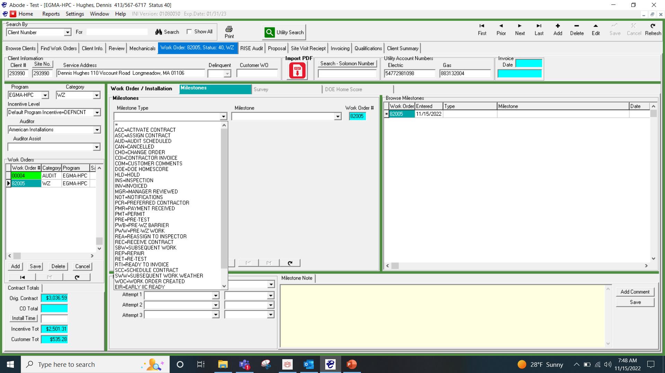
Milestones
Milestones are added here
Can be used to track all phases of the contract
For example a signed contract is a milestone. A weatherization schedule date is another milestone. There maybe other milestones that Abode will want an HPC to track
Since HPCs will no longer be importing and exporting projects, they will be updating the milestones throughout the projects life cycle

Slide 19
Google Drive storage
Document storage for EPlus projects previously done in Docuware; for Abode-owned EPlus projects, document storage now through Google Drive
Google Drive folder link automatically created on customer record upon approval/validation
Copy/paste Drive link into web browser
Documents generated out of EPlus must be uploaded into the customer’s Drive folder

Slide 20
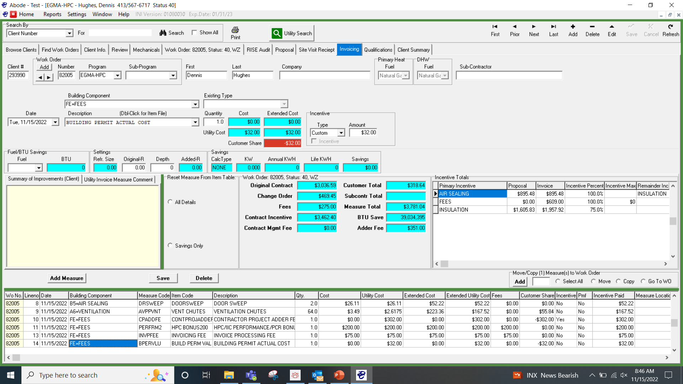
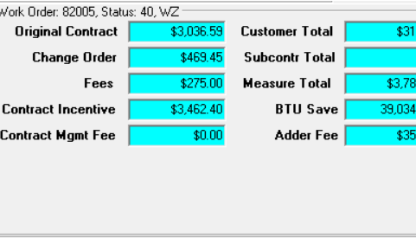
Invoicing
This tab should be populated from the proposal tab by hitting bill utility button when you are ready to submit invoice documents to Google Docs
Add appropriate fees
The HPC will enter any change order items before submitting for billing.
On client Info Screen you will set status to a 35 to alert Abode the WZ is ready to be paid out.
Once set to status 35 you will not be able to change the project.

