Slide 1
WX Scheduling (Required For Abode)
Abode Energy Management

Slide 2
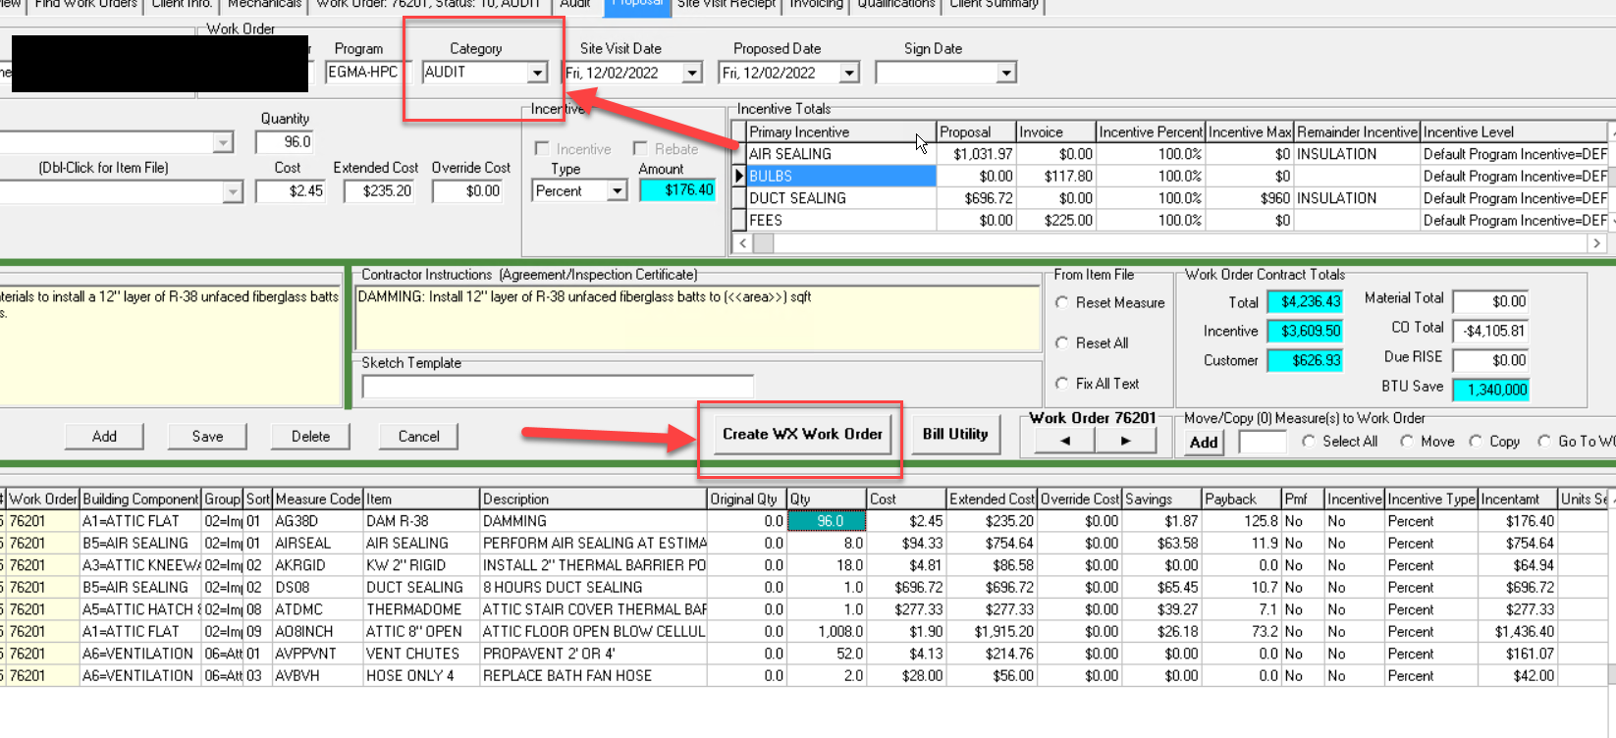
Weatherization Work Order (Process for Signed Contracts & Install Date)
When the customer signs contracts and schedules weatherization:
In the Proposal tab of the audit project (shown right)
Verify you are in the audit project on the top of the screen. Category should say AUDIT.
You will then hit “Create WX Work Order”
This creates a new work order; copying all line items from the Proposal tab of the Audit Project and moving them to the WX Project automatically.

Slide 3
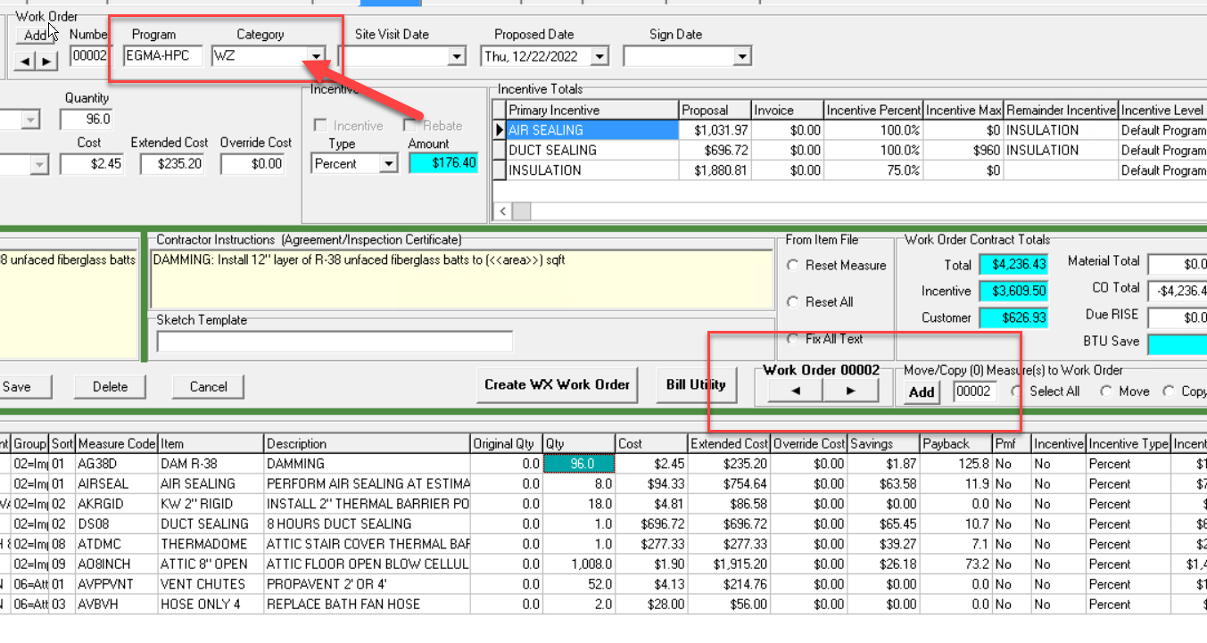
Weatherization Work Order (Process for Signed Contracts & Install Date In House) Cont
As shown, a new work order will be created and placed in Category WZ or Weatherization
You can toggle between WZ and Audit on the bottom right using the left and right arrows
Pay attention to which work order you are in
The status of the weatherization work order will be automatically set to status 30-HPC Review in the Client Info Tab
You want to be in the WZ Work Order for the remainder of this process

Slide 4
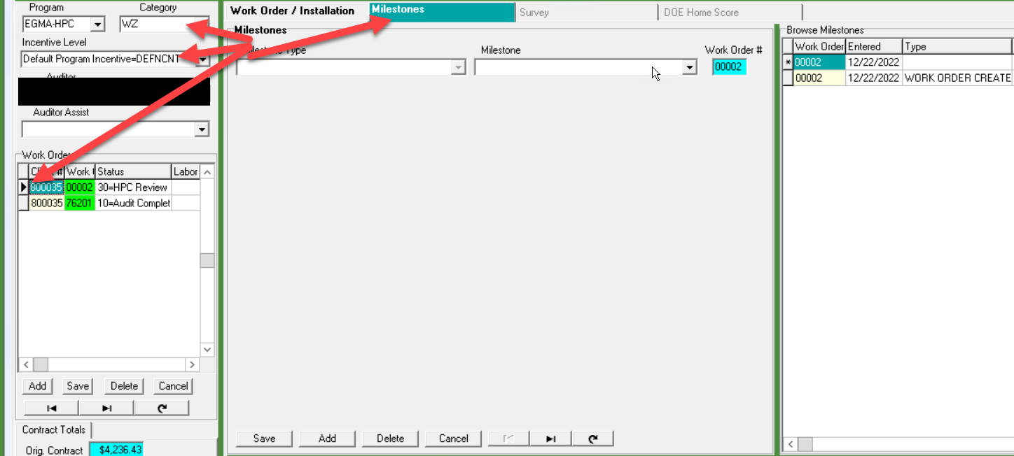
Weatherization Work Order Tab (WX Scheduling & Incentive Level)
Once work order is created, navigate to the Work Order tab at the top of the page. In the Work Order tab there is a sub tab called Milestones. Here you will create milestones to track the project progress.
Milestones include:
WX Scheduled
Pre-Weatherization Barrier
Job on Hold
Ready to Invoice
etc…
You will also be able to select the incentive level for the weatherization project (such as moderate income, default, or renter). This should also be changed in the audit tab
The main milestone we are looking for is WX Scheduled—required for Abode inspection logistics and HPC scheduling compliance.

Slide 5
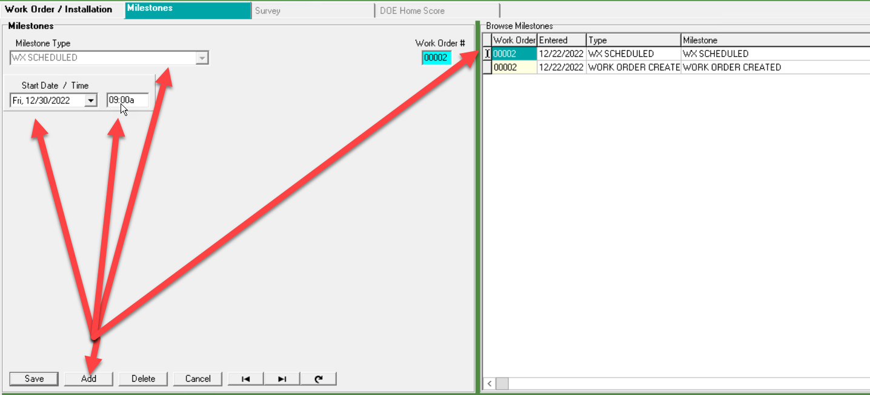
Weatherization Work Order (WX Scheduling) Required for Abode
To create a Milestone:
Click Add > Milestone Type, WX Scheduled > Start Date > Start Time
Use TAB to move through the sections. TAB works as a save function.
The Milestone will then appear on the right under Browse Milestones.

Slide 6
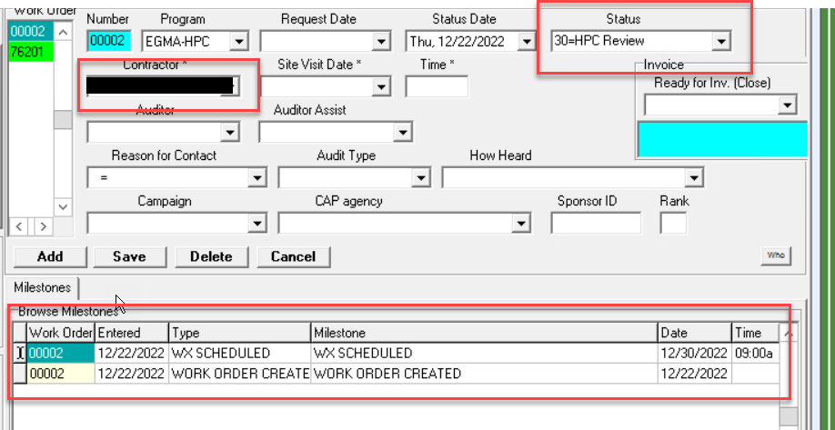
Weatherization Work Order (Milestones Reviewed in Client Info Tab)
Milestones can also be viewed from the Client Info Tab of the weatherization work order (shown right) . This is an easy way to track and review milestones since you can toggle back and forth from Audit and WZ work orders in the Client Info tab.
Once verified that the milestone is set up this project is all set until after weatherization is complete!

Slide 7
Weatherization Invoicing
Abode Energy Management

Slide 8
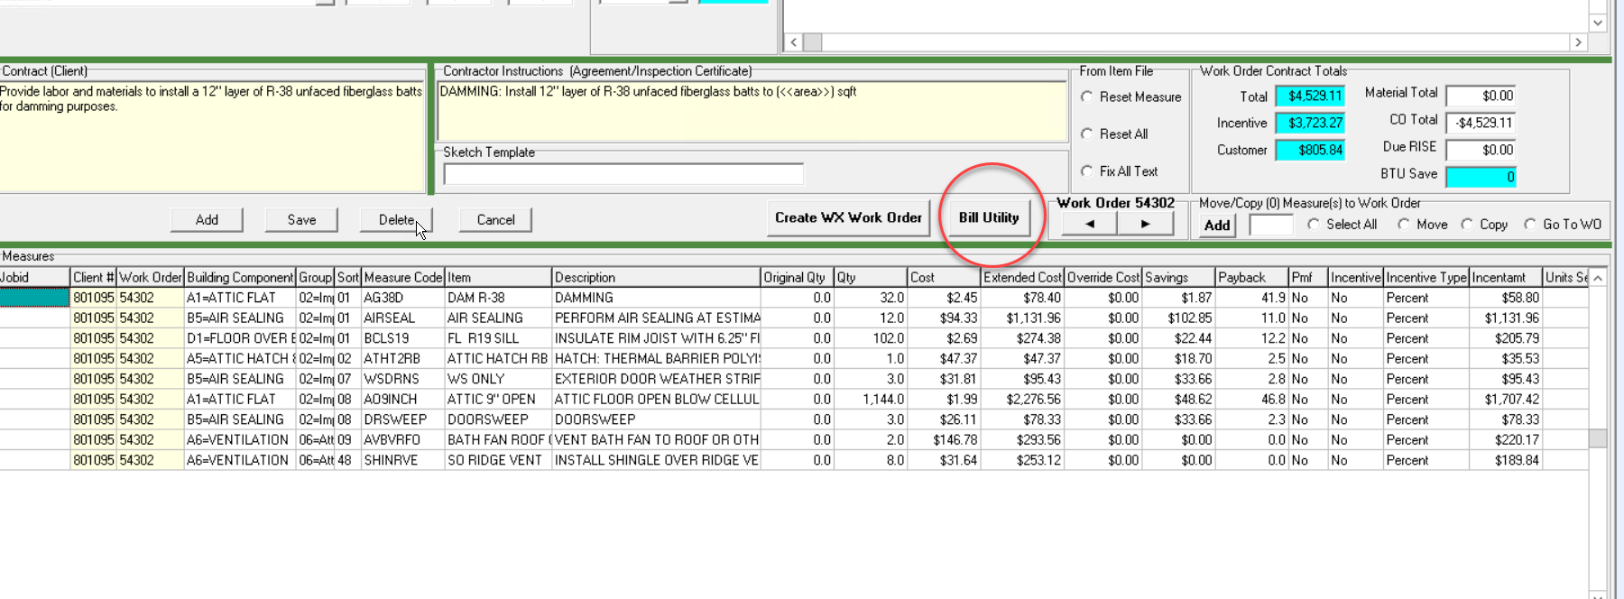
Invoicing
Once weatherization is completed and you are ready to bill for the job head back to the Proposal Tab in the Weatherization Work Order (WZ)
Here you will now click Bill Utility to create the invoice.
It will highlight all of the line items and move them to the invoicing tab

Slide 9
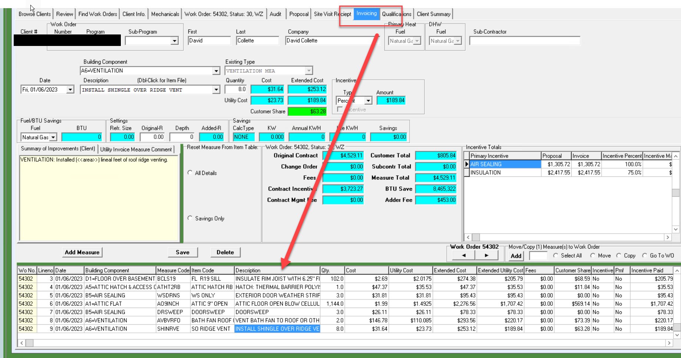
Invoicing (Cont)
The Invoicing tab is the 3rd to last tab located at the top
All the line items that were in the proposal tab will be moved to this tab.
Here you will be making all of the Change Orders. You can add, change quantity, etc all the line items you want here.
You will also be adding all of the permit fees, adders, etc. (Shown on next page)

Slide 10
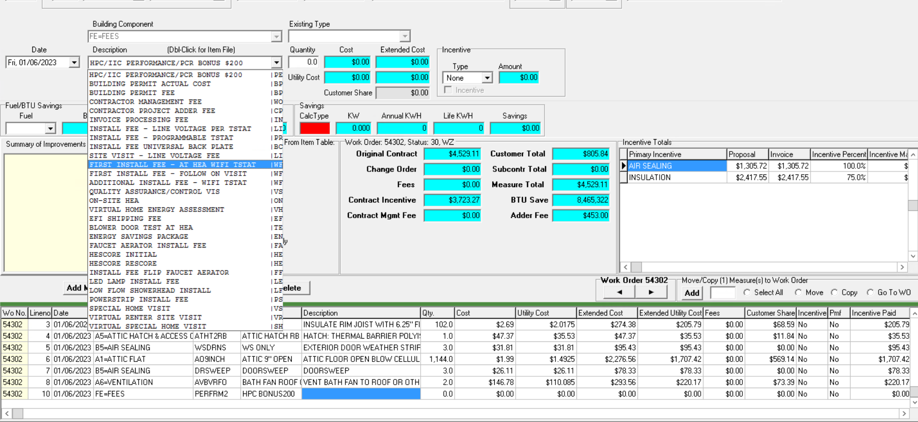
Invoicing (Cont)
The first 6 line items are what can be added

Slide 11
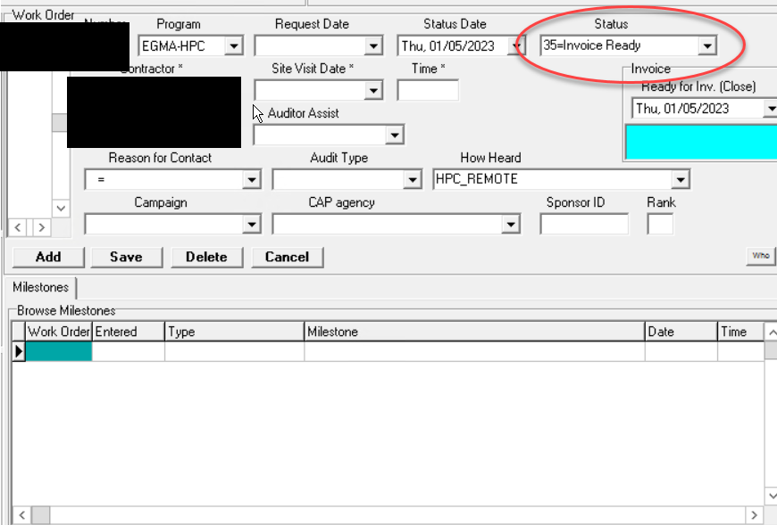
Invoicing (Final Step)
Once your invoice is completed AND all relevant paperwork from the weatherization install is uploaded to the Google Drive you may now set the Status to 35=Invoice Ready
Once set, this will be in Abode’s court to review the job

Slide 12
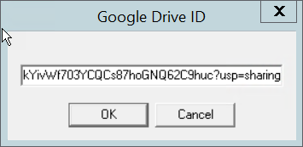
Google Drive Link Lookup Location
MUST HAVE A GOOGLE ACCOUNT TO UPLOAD DOCUMENTS TO DRIVE
Secondary link for the Google Drive is located in the Review Tab > HPC Status Review / Save with the Google Drive Folder ID
Click on the Google Drive logo
The https address will show up on in a small window called Google Drive ID
Copy and Paste that into your internet browser and it will open up the Drive folder.

Slide 13
Weatherization Invoicing Fails
Abode Energy Management

Slide 14
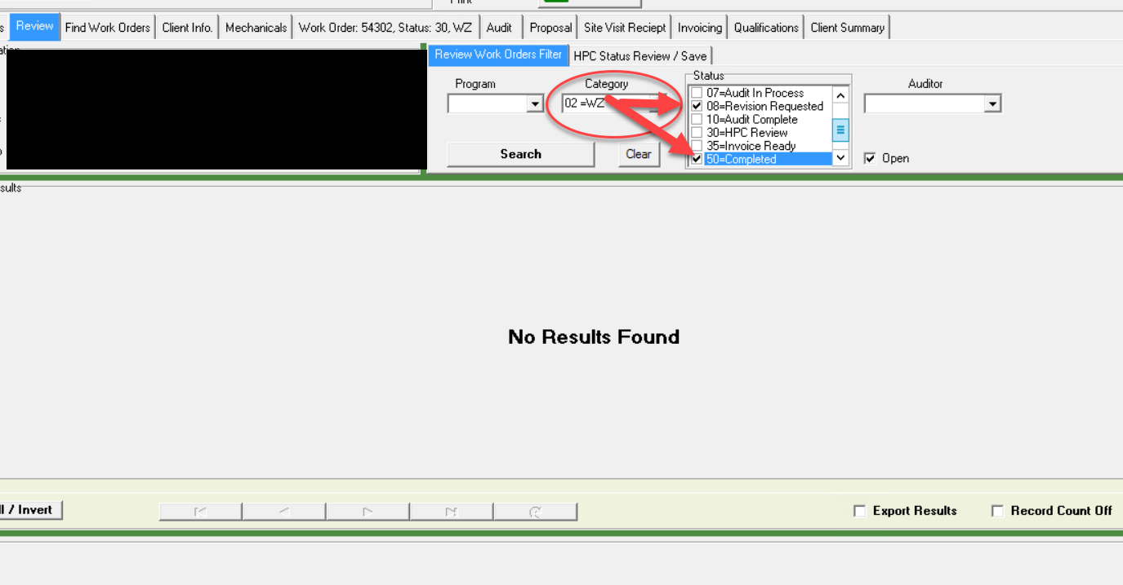
Locating Failed & Completed Invoices
To Review Invoice results, navigate to the Review Tab
Select Category 02 = WZ
Check 08 = Revision Requested (Invoice Fails)
The next few slides go over how to locate why the invoice and how to close that out.
Status 50 = Completed is what Abode sets when the invoice passes Review

Slide 15
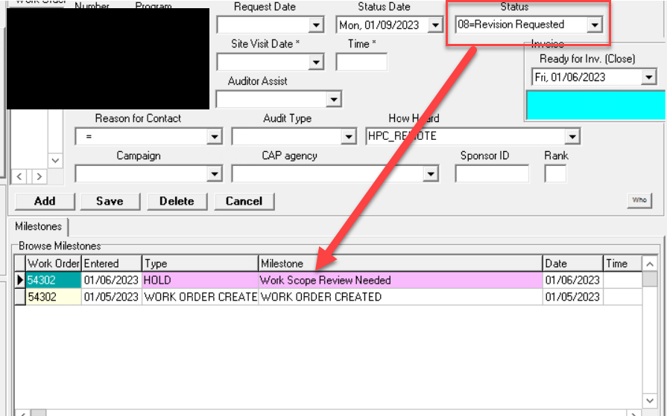
Invoice Fails
If an invoice fails review, Abode will set the status to 08 = Revision Requested in the weatherization work order
The Milestone shown at the bottom will be Type Hold, Work Scope Review Needed (This will be changed to “Invoice Review Needed” soon)

Slide 16
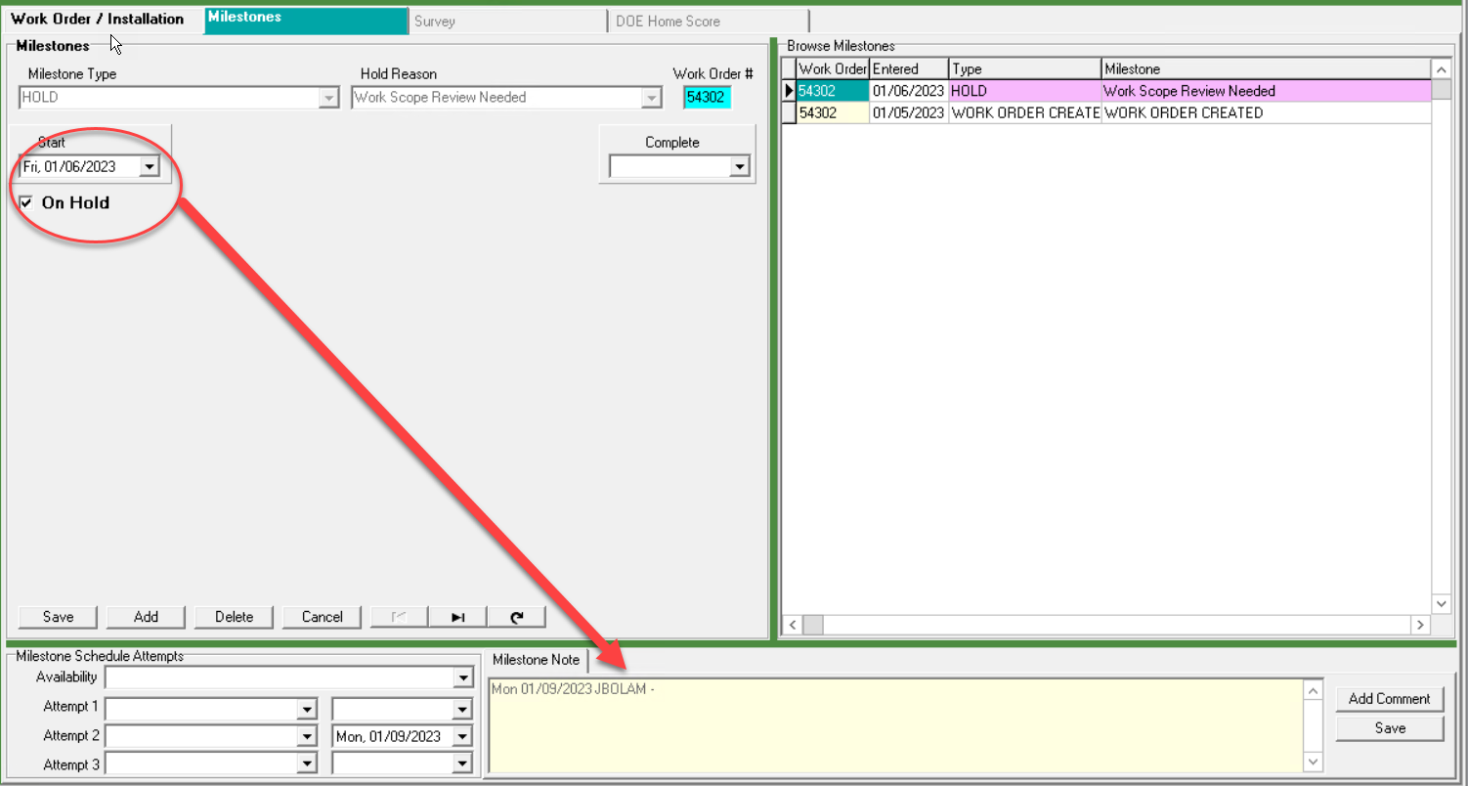
Invoice Fails (Cont)
In the Weatherization Work Order, navigate to the Work Order Tab.
Here you will find the Milestones and information as to why the invoice needs review.
Abode will select the start date of when the review occurred and add a comment in the Milestone Note as to why the invoice failed.

Slide 17
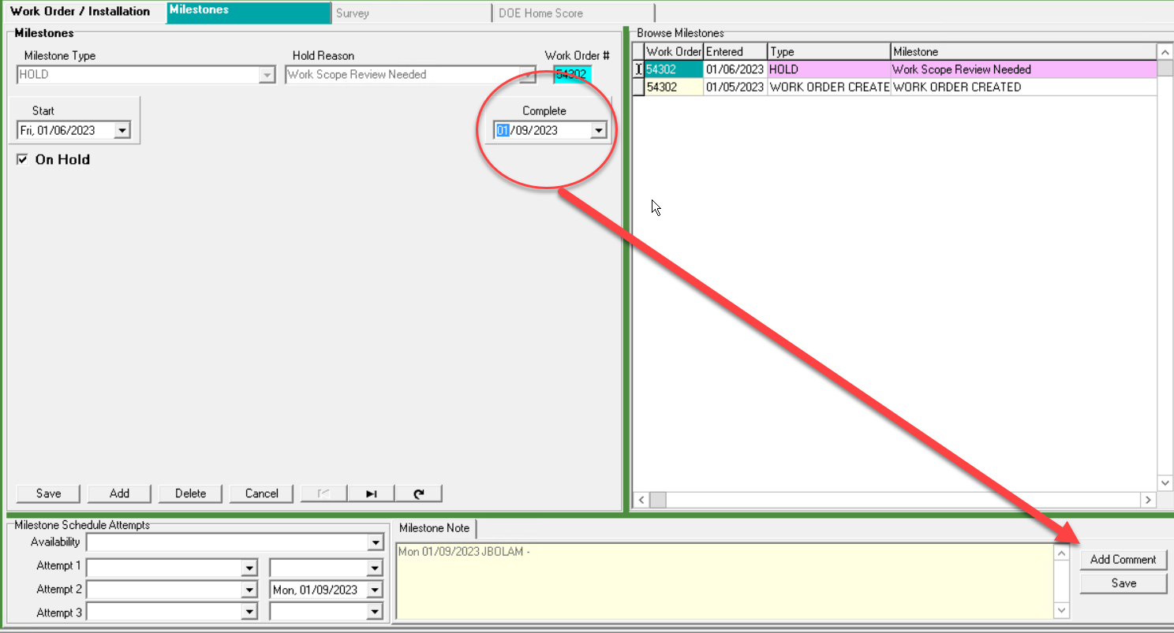
Invoice Fails (Cont)
To close out a fail. Select the date of completion
Then Add Comment on what was done to complete the given task and hit save
Navigate back to the client info tab and set the status back to 35 = Invoice Ready

